Slide 1
Unit - 3

Slide 2
Getting the source code
Install git
Source code -GitHub
$ git clone -b chapter-03 https://github.com/simonholmes/getting-MEAN.git
To run the app….
install some dependencies with the following commands:
$ cd getting-MEAN
$ npm install

Slide 3
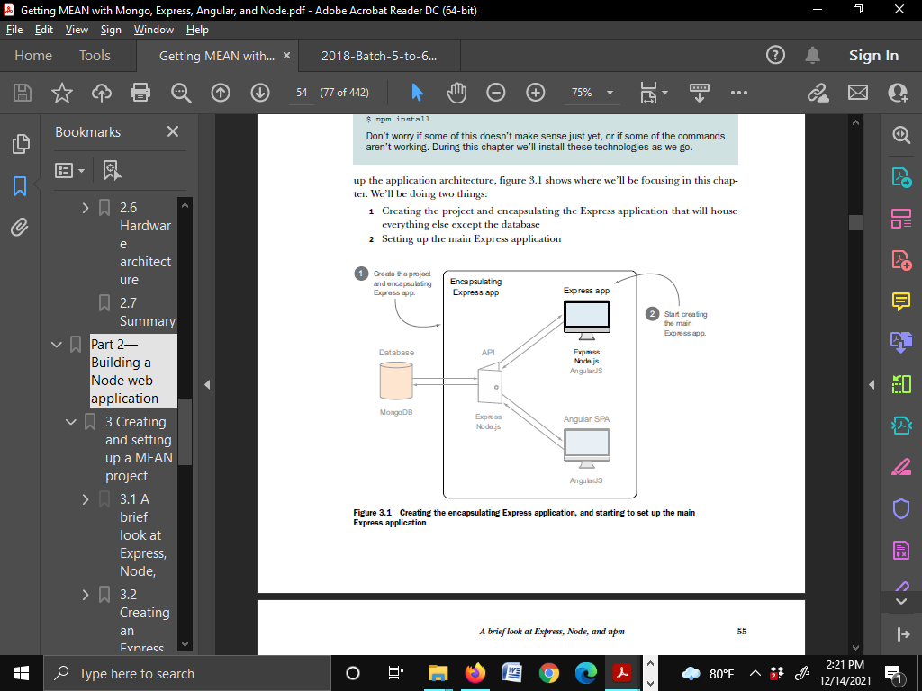
Create and setup Express

Slide 4
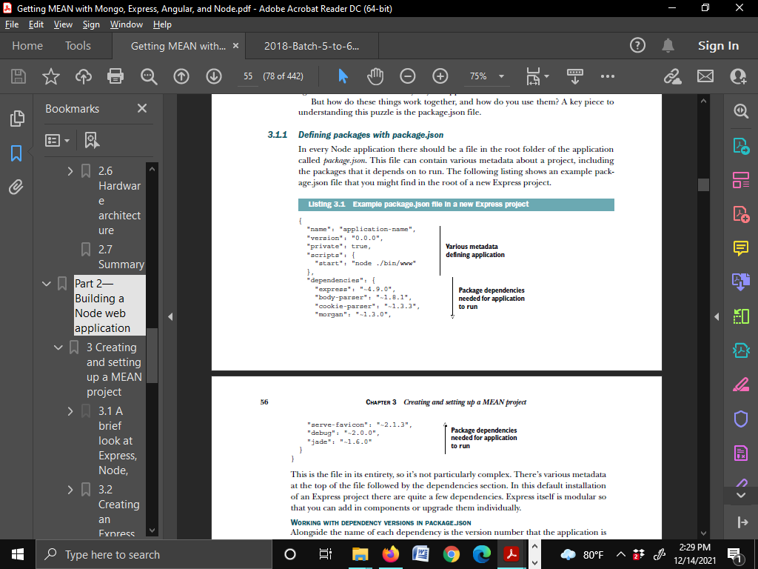
Package.JSON (Express prj)

Slide 5
Working with dependency versions in package.json
Express 4.9.0.
It specifies a particular version at three levels:
■ Major version (4)
■ Minor version (9)
■ Patch version (0)
~ → application will use the latest patch version available.

Slide 6
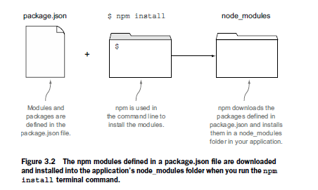
Installing Node dependencies with npm
$npm install
$ npm install --save package-name

Slide 7
UPDATING PACKAGES TO LATER VERSIONS
npm install…. installs
The version defined in the package.json file
The latest patch version on npm (assuming you used the ~)
The version installed in the node_modules folder

Slide 8
Creating an Express project
To create an Express project :
■ Node and npm
■ The Express generator installed globally
■ Git
■ Heroku
■ New command-line interface (CLI) or terminal

Slide 9
Installing the pieces
VERIFYING THE INSTALLATIONS
$ node --version
$ npm --version
$ express –version
Configuring an Express installation
$ express
C:\users\user
(This would install the framework with default settings into your current folder).

Slide 10
A QUICK LOOK AT JADE
Jade template
#banner.page-header
h1 My page
p.lead Welcome to my page
<div id="banner" class="page-header">
Compiled output
<h1>My page</h1>
<p class="lead">Welcome to my page</p>
</div>

Slide 11
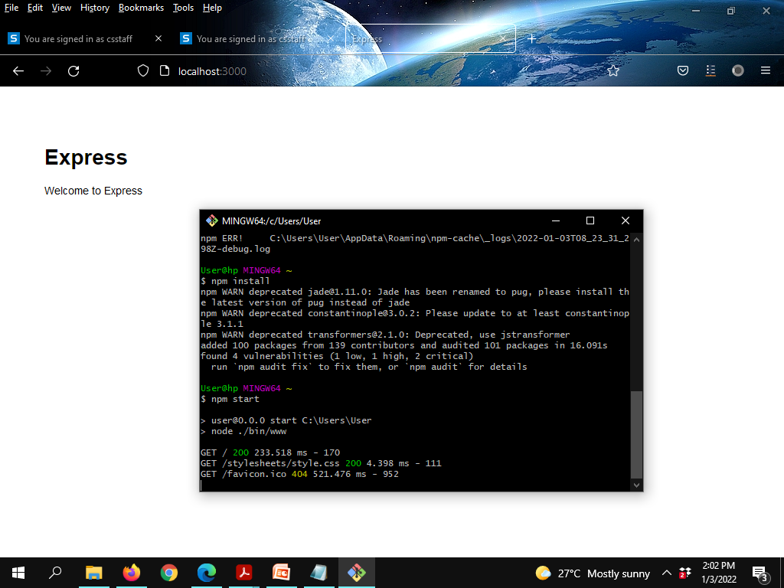

Slide 12
AUTOMATICALLY RESTARTING THE APPLICATION WITH NODEMON
$ npm install -g nodemon

Slide 13
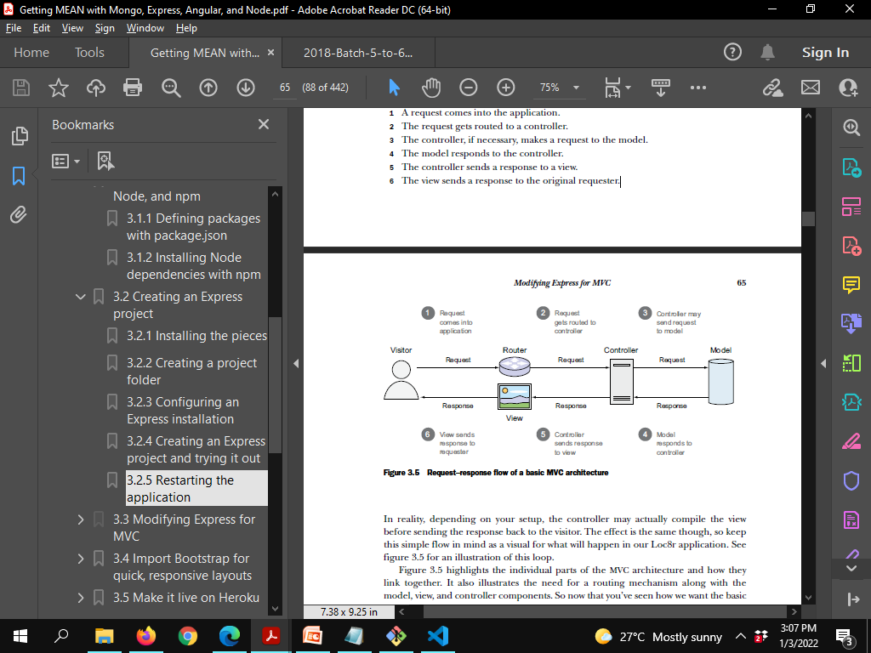
Modifying Express for MVC
1 A request comes into the application.
2 The request gets routed to a controller.
3 The controller, if necessary, makes a request to the model.
4 The model responds to the controller.
5 The controller sends a response to a view.
6 The view sends a response to the original requester.

Slide 14
Request-Response flow
1 A request comes into the application.
2 The request gets routed to a controller.
3 The controller, if necessary, makes a request to the model.
4 The model responds to the controller.
5 The controller sends a response to a view.
6 The view sends a response to the original requester.

Slide 15
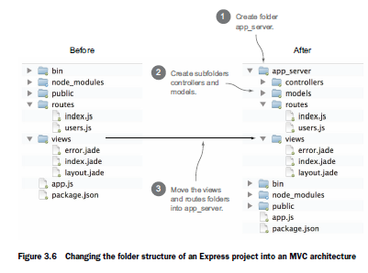
Changing the folder structure

Slide 16
Using the new views
USING THE NEW VIEWS FOLDER LOCATION
In app.js(modified in bold as below)
app.set('views', path.join(__dirname, 'views'));
app.set('views', path.join(__dirname, 'app_server', 'views'));

Slide 17
Using the new routers
USING THE NEW ROUTES FOLDER LOCATION
In app.js(modified in bold as below)
var routes = require('./routes/index');
var users = require('./routes/users');
var routes = require('./app_server/routes/index');
var users = require('./app_server/routes/users');

Slide 18
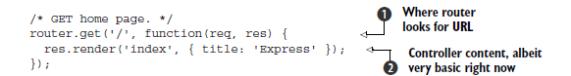

Splitting controllers from routes (UNDERSTANDING ROUTE DEFINITION)
index.js

Slide 19
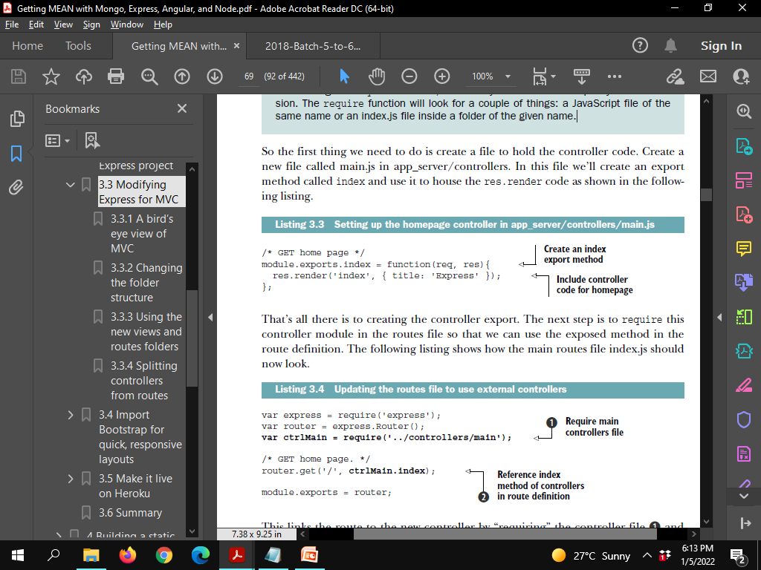
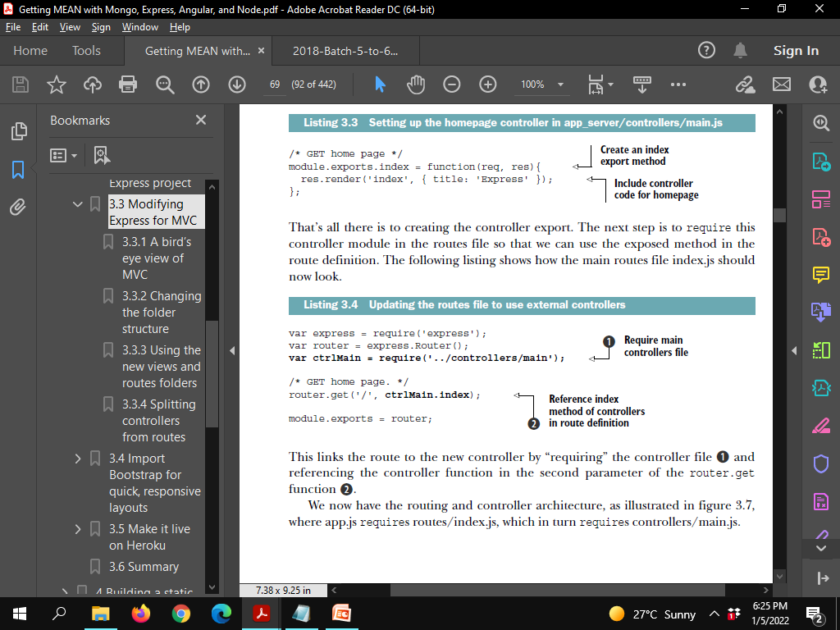
MOVING THE CONTROLLER OUT OF THE ROUTES FILE
Create an export method (index) : for the res.render code
index.js

Slide 20
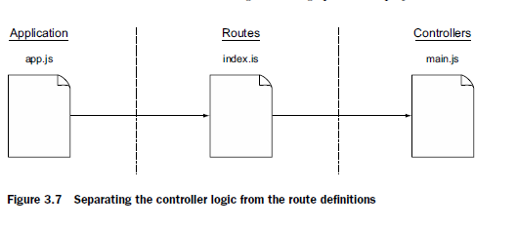
Separate controller login from route definitions

Slide 21
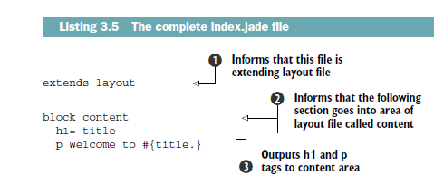
Import Bootstrap for quick, responsive layouts

Slide 22
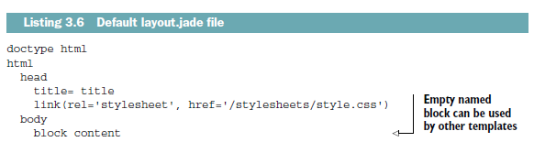

Slide 23
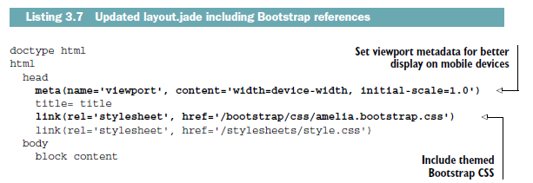
ADDING BOOTSTRAP TO THE ENTIRE APPLICATION
■ Reference the Bootstrap CSS file.
■ Reference the Bootstrap JavaScript file.
■ Reference jQuery, which Bootstrap requires.
■ Add viewport metadata so that the page scales nicely on mobile devices.
layout.jade

Slide 24
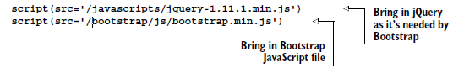
layout.jade(Contd)

Slide 25
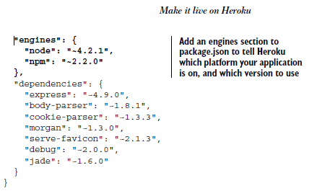
Heroku set up
Update Package.json
Creating a Procfile
Testing it locally with foreman

Slide 26
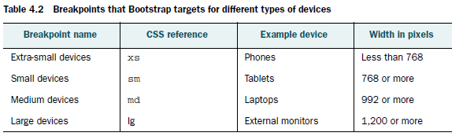
Creating some views

Slide 27
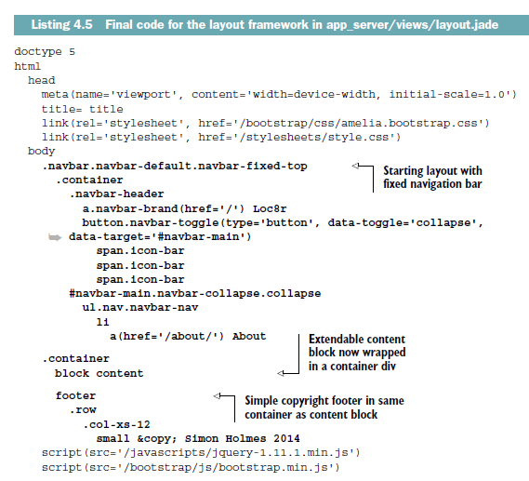
Sample layout.jade code

